Slide 1
Honeywell Amplifier Problem
ME476C
Team 29
Presentation 2
Savana Bezdicek, Nicole Mitich, Luke Plumb, Isaac Romero, and Jacob Setzer

Slide 2
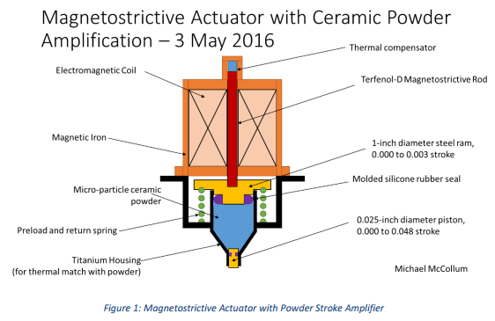

Project Description
Background:
2015-2016 Honeywell Capstone group constructed a proof-of-concept Terfenol-D actuator.
  Successful, but not practical for real-world application
Goal:
Develop a practical “fluid” amplifier by matching coefficients of thermal expansion of fluid and housing.
Nicole Mitich
10/26/16
Team 29: Honeywell Powder Amplifier

Slide 3
Designs Considered
Powdered steel
Change metal housing to ceramic & utilize a ceramic powder to function as a fluid
Cenospheres
Xerogel
Salt
Sand
Ethylene glycol antifreeze (meets lower temperature requirement)
Paraffin (thermal insulating capabilities)
Heat sinks on outer wall to dissipate excess heat, reduce expansion of amplifier liquid
Dowtherm J (thermal oil, fits into temperature bounds)
Add insulating material between actuator & amplifier wall
Mineral oil
Inner coating on the inside of the housing (what the fluid will be in contact with)
Introduce cooling system in chamber, possibly a coolant to flow through the amplifier liquid
Create an hourglass chamfer to replace the linear chamfer to increase the flow amplifier liquid or powder
DOT 5.1 brake fluid (higher boiling point, may reduce the coefficient of expansions within the temperature range)
Layering with metal housing, insulation, ceramic
Paratherm CR
Honey (viscous), hexagonal packing
Spider webbing as brake fluid replacement
Fibrocartilage matrix (meniscus cushions impact from knee)
Fire ants (will most likely be compressible and would die from lack of oxygen, but act as a liquid under circumstances)
Savana Bezdicek
10/26/16
Team 29: Honeywell Powder Amplifier
Notes:
Methods: 6-3-5, brainstorming

Slide 4
Designs Considered
Concepts | Amplifier Materials | Advantages | Disadvantages
Bio-inspired Designs | Honey Fire ants Spider webbing Fibrocartilage matrix | Creative | Not practical for use in a primarily mechanical actuator
Powder Materials | Cenospheres Zirconia | Greater probability to match thermal coefficient of expansions | Minimal information available May or may not act as a fluid (analysis needed)
Liquid Materials | Brake fluid Dowtherm J Paraffin Paratherm CR | Actuator is currently designed for liquid material in amplifier | Most are a power of 10 higher (thermal coefficient of expansion) than the housing
Mechanical Additions | Heat sinks Lever system Hourglass chamfer | Reduce need for customer requirements (fluid-like powder, sealing mechanism, match expansion coefficients) | Heavy design & analysis needed to determine feasibility
Jacob Setzer
10/26/16
Team 29: Honeywell Powder Amplifier
Notes:
Powder materials

Slide 5
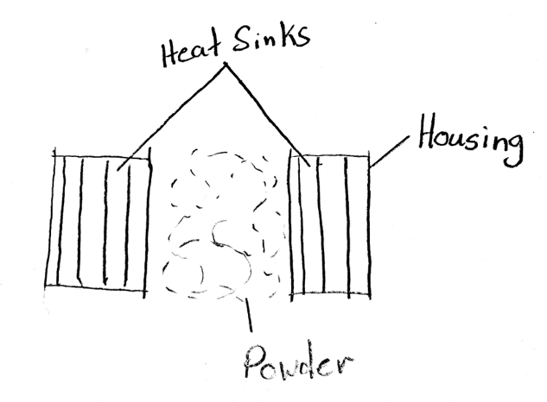
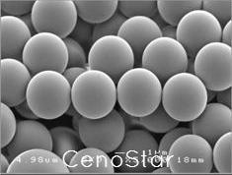
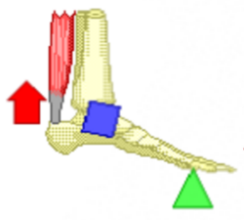
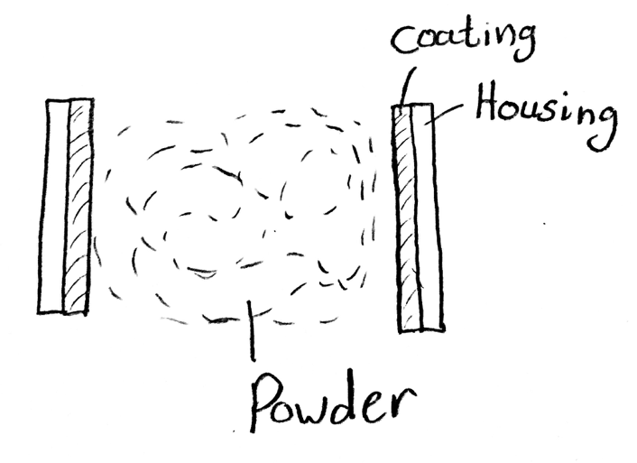
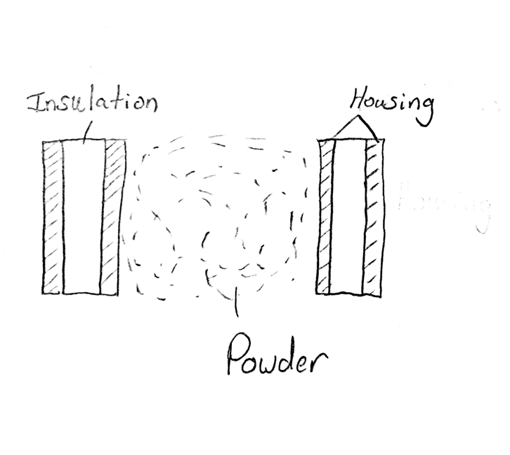
Designs Selected
Cenospheres Heat Sinks Lever System
Inner Coating Insulation
Jacob Setzer
10/26/16
Team 29: Honeywell Powder Amplifier

Slide 6
Designs Selected
Customer Requirements | Weights
Powder acts like semi-fluid | 0.2
Practical application for chosen materials | 0.2
Output amplification maximized | 0.15
Demonstrator retracts when force is removed | 0.1
Sealing mechanisms on demonstrator | 0.09
Fatigue failure minimized | 0.06
Match body and powder coefficients of thermal expansion | 0.2
Top Designs for Consideration:
Cenospheres - 73.2
Mechanical Lever - 64.25
Coating and Insulation - 60.25
Isaac Romero
10/26/16
Team 29: Honeywell Powder Amplifier
Notes:
Indicate how this design meets the Customer Requirements (summarize as space limitations require)

Slide 7
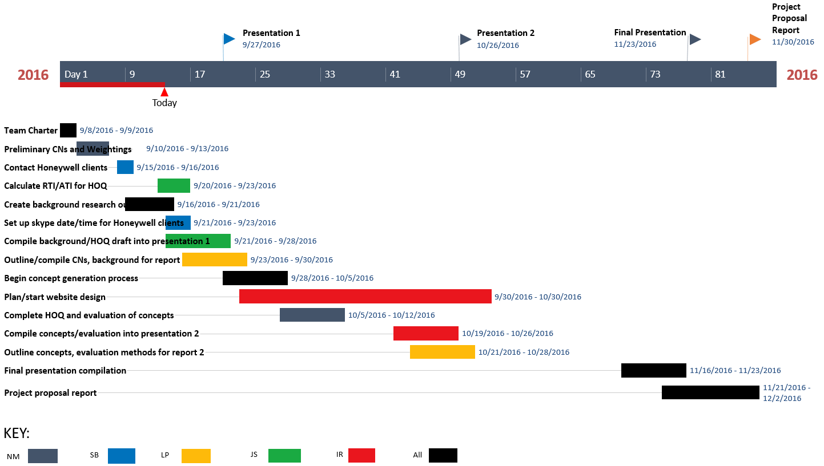
Schedule and Budget
Currently on-schedule for completion
Luke Plumb
10/26/16
Team 29: Honeywell Powder Amplifier

Slide 8
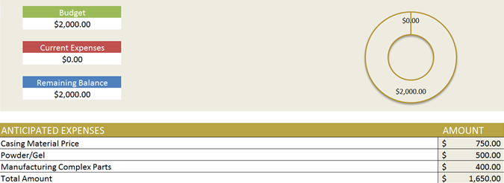
Schedule and Budget
Luke Plumb
10/26/16
Team 29: Honeywell Powder Amplifier

Slide 9
Questions?

